Slide 1

Ar Junior [ AI Model ]
Made by; Josheph Dangi
Aadarsha Ghatane

Slide 2
Ar Junior
Ar junior is Ai model Created using Python with
the help of groq api. It is a applications which gives
answer of questions given by the user. It is little
different from other Ai cause it reply’s the user
using Nepali language.

Slide 3

Advantages of Ar Junior
Easy to use.
Increase productivity.
Increase your Knowledge.
Get solution of problems.
Data analysis and insights.
Accessive learning for all.

Slide 4

How to use Ar Junior
AR Junior is available for Pc and Laptop it is not
Available for smart phones.
First, search github in chrome.
Download AR Junior file from github.
Than install it in your pc.
It is ready to use it.

Slide 5
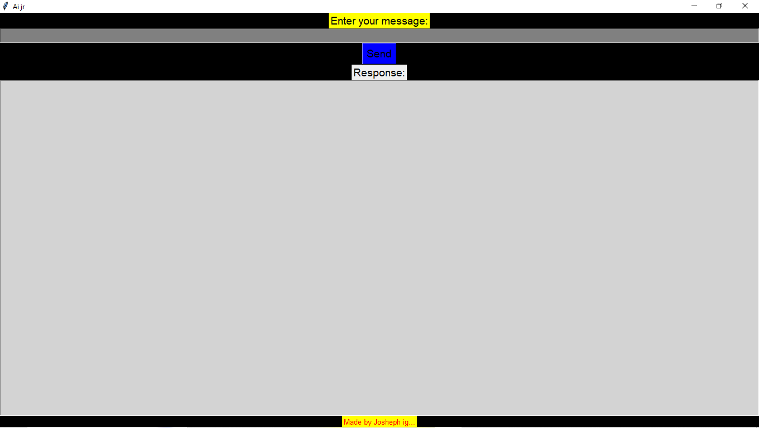
Home page of AR Junior

